Slide 1

PartyFinder
Brisan Brown, Benji Charles, Sri Harshini Donthineni, Alexander Franco, Justin Mckenzie

Slide 2
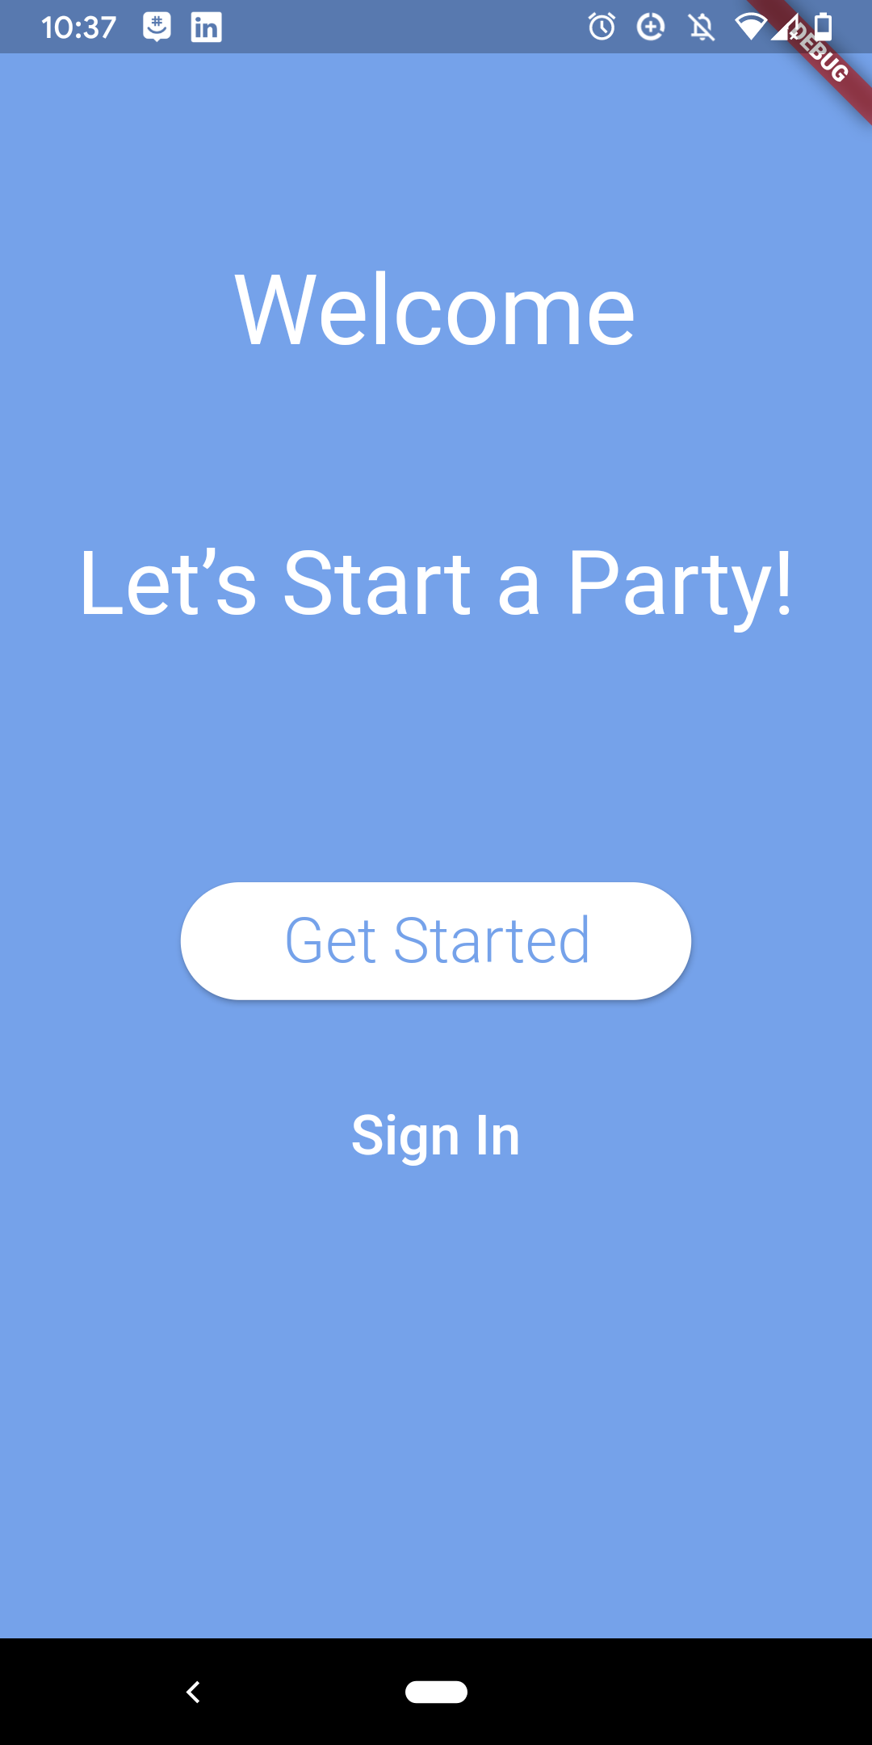
WHAT IS PARTY FINDER?
We Created Party Finder App, which will stand a sort of social media exclusively for the sake of creating and finding events. Users can add their own listings with custom guidelines for each of their events along with a functional mapping system to the event. Additionally, a rating system will be applied for users to view and also allow our users to chat in our app.

Slide 3

Platforms and languages Used?
Originally we planned on doing our entire project on Kivy(python crossplatform GUI package), Everything was going well until the second increment where we figured out that not all functionalities we mentioned for our app are supported in Kivy.
Due to lack of documentation and resources online for Kivy, we decided to switch our platform to Flutter and Dart like 2 weeks ago.
So we did everything that we see on the app after increment 2 because we couldn’t use our previous code.

Slide 4
Functionalities Of the App
Login: Allows the Users to login by creating an account or with google or just as a guest
Events: Users can create new events by providing the required information
Listings: Users can see List of events created by all the users
Attendence(check-in): People can checkin, and everyone can see hoe many people are attending
Rating: Users can rate each event on a star-based system
Maps: Users when creating the events are able to search for the location of the event using google maps suggestions.
Following: almost there…
Share: We can share the events to any other platforms like Twitter, Facebook, text, email etc. on your phone.
Chat: Able to chat in the App

Slide 5
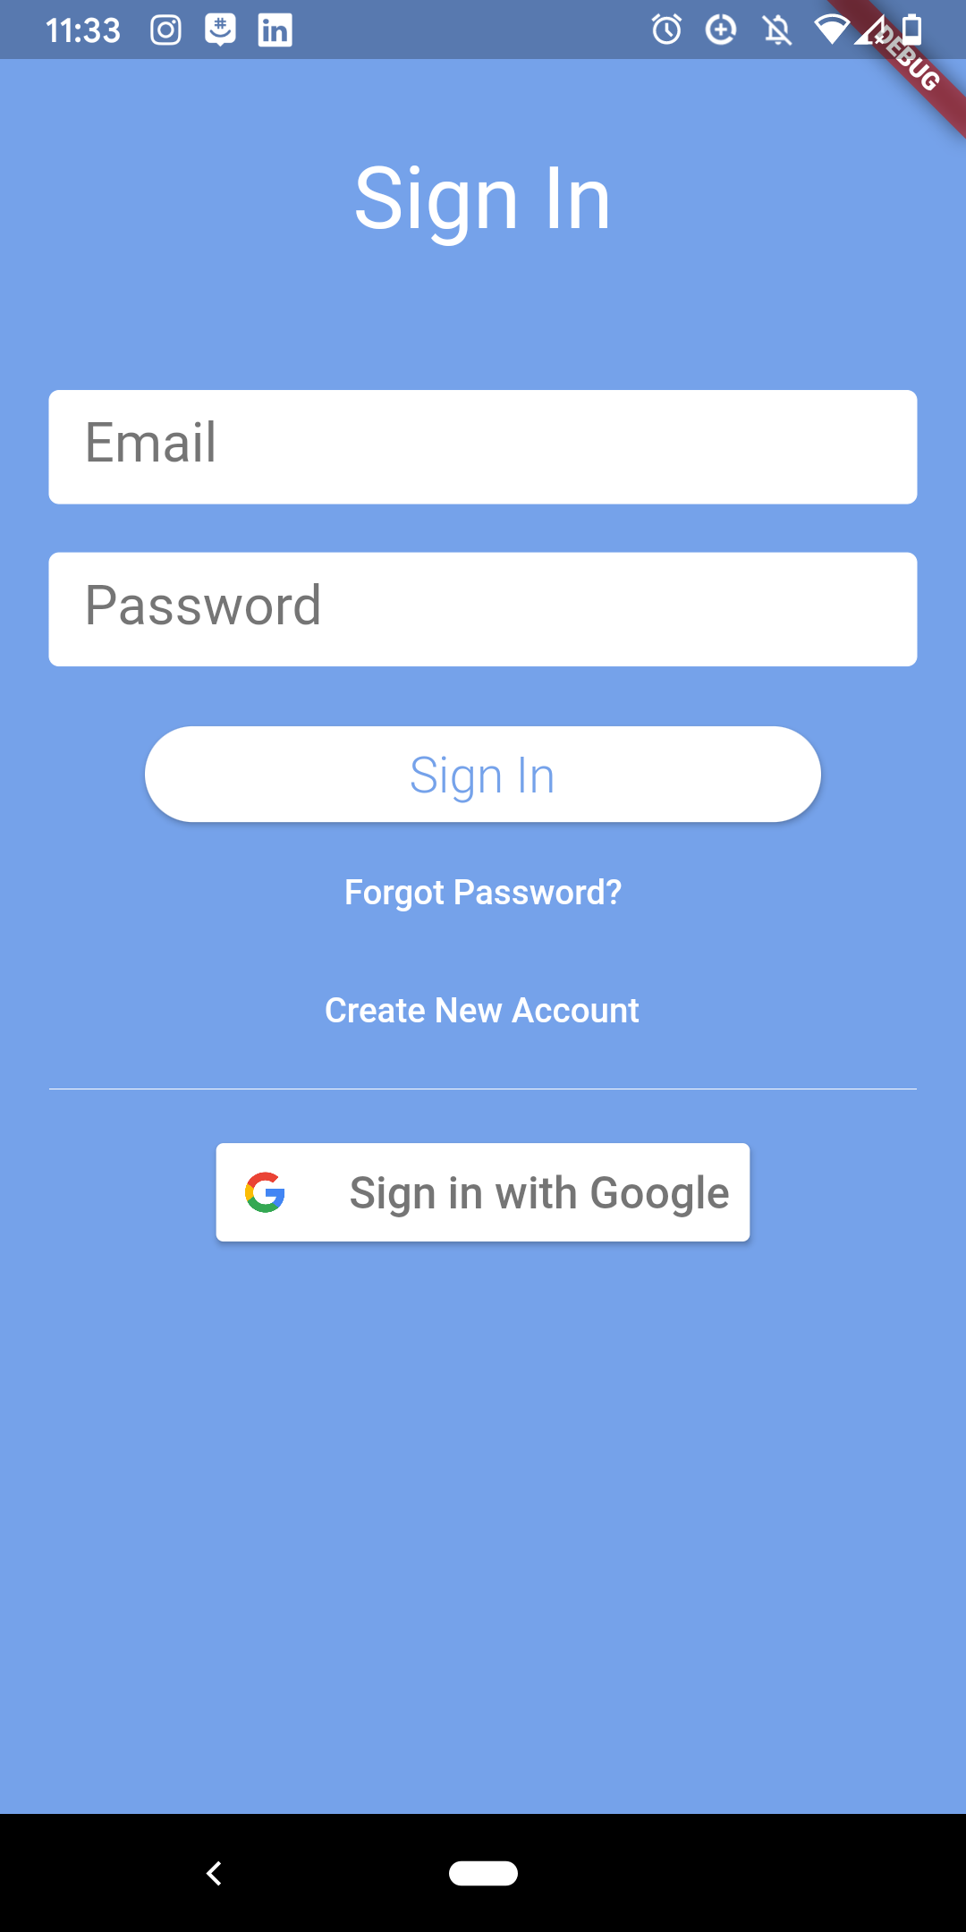

Implementation
Login Page: Firebase auth, Cloud Firestore, google signin, flutter auth buttons.
Event Flyers: Dart share and Smooth star rating in Dart, includes google maps functionality
Chat: Used firebase to Store the messages, cache the message logs.

